Slide 1
TWITTER SENTIMENT ANALYSIS
Team members:
1.Atchaya.S
2.Anitha Rajam.M
3.Dheekshitha.D
Industry Mentor
Mr.Vasanth
Faculty Guide:
Mrs.Suganthi
Department of CSE, KGiSL Institute of Technology, Coimbatore

Slide 2
Abstract
This project addresses the problem of sentiment analysis in twitter, that is classifying tweets according to the sentiment expressed in them (i.e positive, negative).
Due to large amount of usage we hope to achieve a reflection of public sentiment by analysing the sentiments expressed in the tweets.
Analysing the public sentiment is important for many applications such as firms trying to find out the response of their products in the market.
The aim of this project is to develop a functional classifier for accurate and automatic sentiment classification of an unknown tweet stream.
Department of CSE, KGiSL Institute of Technology, Coimbatore

Slide 3
Area Introduction-Existing system
The Existing work mainly focuses on classifying user into binary sentiment(positive,negative) and they do not go further in mining user sentiment.
The Existing approaches mainly leverage product category infromation or tag information to study the interpersonal influence.
User reviews can provide us ideas in mining interpersonal interference and user preferences.
Department of CSE, KGiSL Institute of Technology, Coimbatore

Slide 4
Proposed System
Advantages
Proposed system will gives you the freedom to choose the data of any topic.
It gives you the impact the results and statistics will have on the respective field.
Proposed system allows retrieval of data based on the query entered by the user.
Proposed system will provide accurate feature selection.
Department of CSE, KGiSL Institute of Technology, Coimbatore

Slide 5
Literature Review
Existing system takes a stored dataset a particular topic into consideration
It fails to determine the impact the results might or will have in the respective field.
Existing system does not allow the retrieval of data based on the query entered by user.
Accurate feature selection will not be provided.
Department of CSE, KGiSL Institute of Technology, Coimbatore

Slide 6
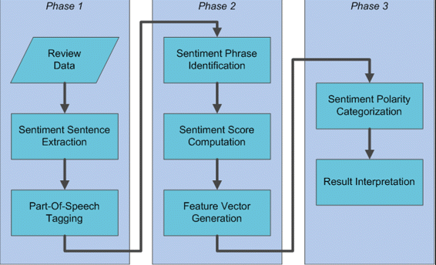
ARCHITECTURAL DESIGN

Slide 7
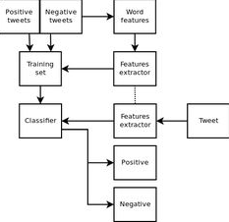
FLOW CHART

Slide 8
Module splitup
Data Extraction
Data Manipulation
Data Analysis
Data Presentation

Slide 9
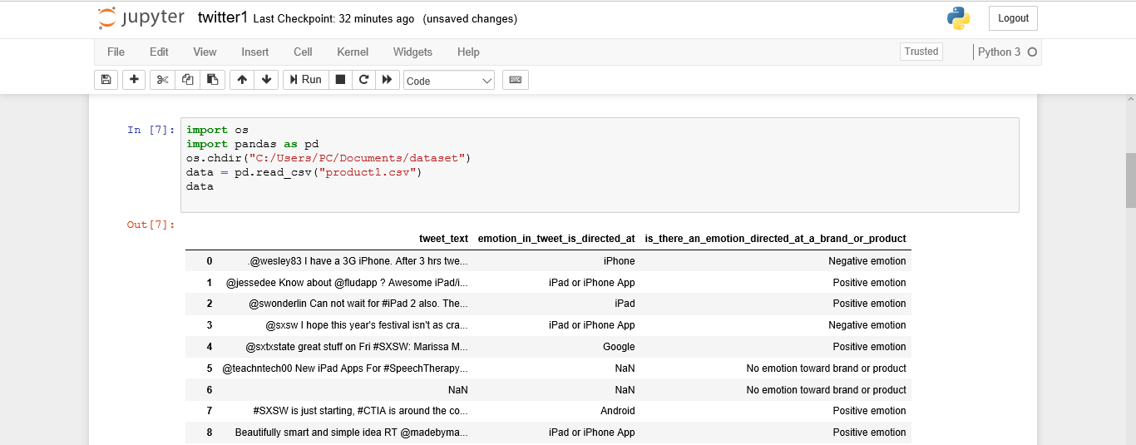
Screen shots of module under progress

Slide 10
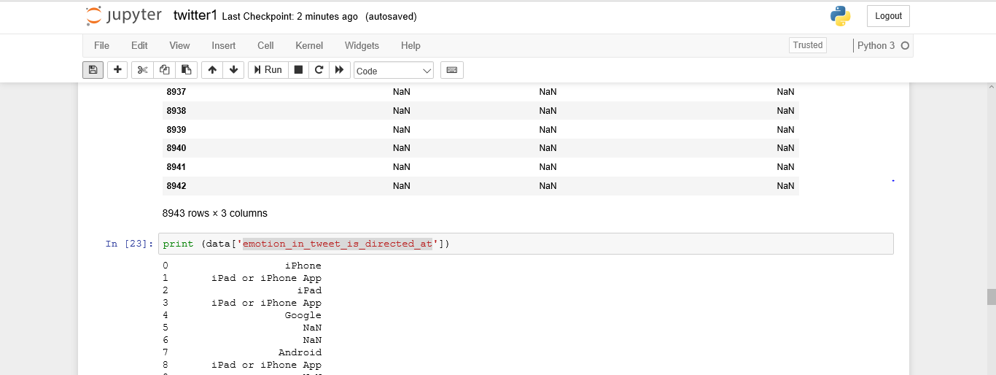
Cntd…

Slide 11
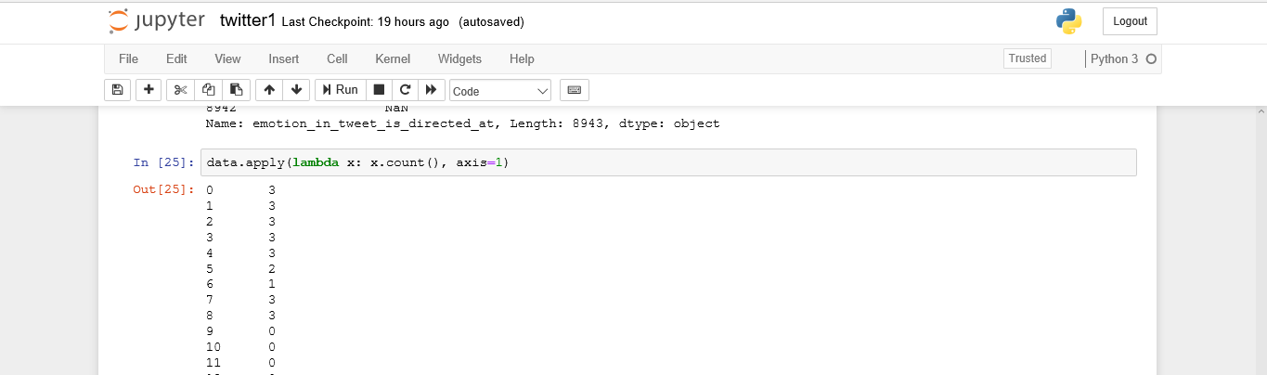
Cntd…

Slide 12
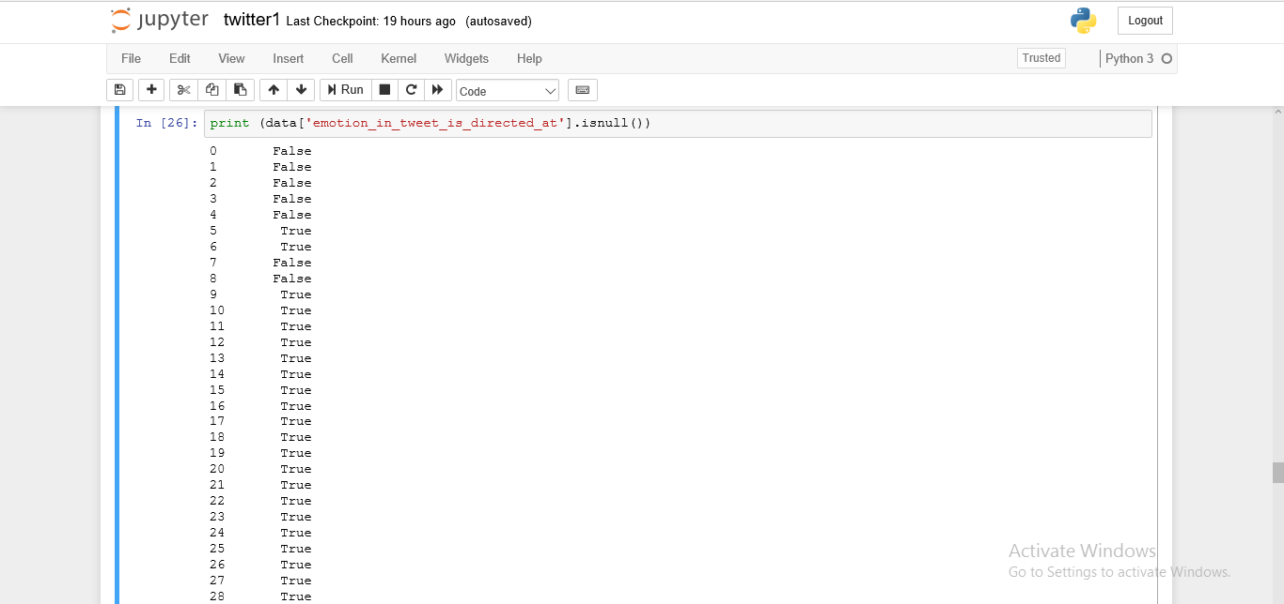
Cntd…

Slide 13
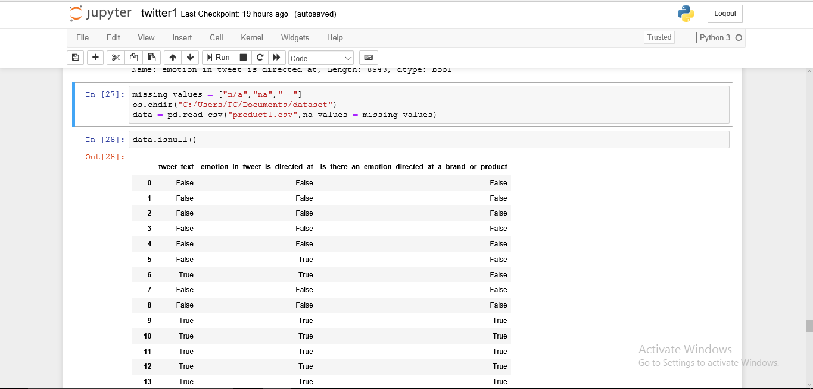
Cntd…

Slide 14
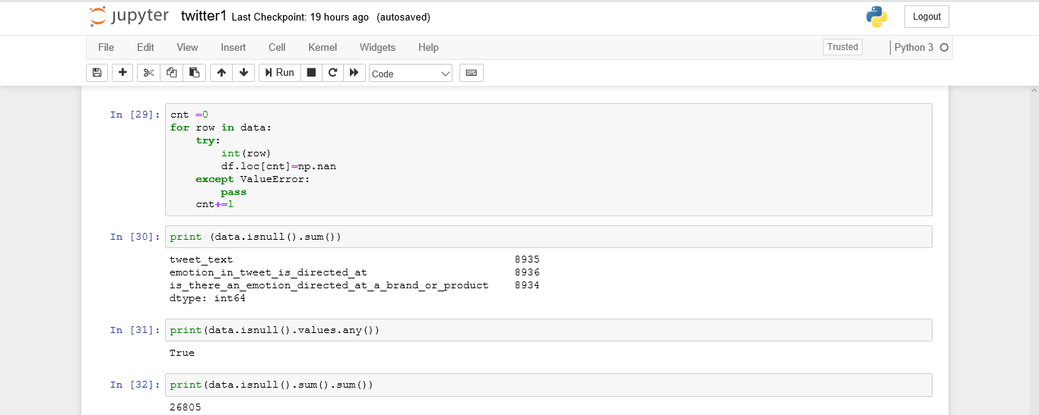
Cntd…

Slide 15
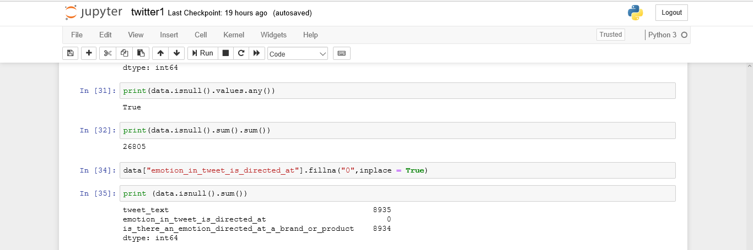
Cntd…

Slide 16
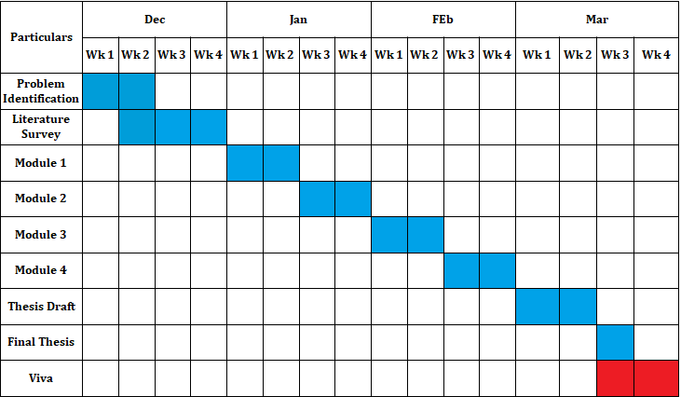
Project Planner / Timeline chart)
Department of CSE, KGiSL Institute of Technology, Coimbatore

Slide 17
THANK YOU

